Slide 1
Using DMPTool to Write a Data Management & Sharing Plan (DMSP)
Lauren Phegley, Research Data Engineer
Moderated by Aman Kaur

Slide 2
Learning Outcomes
Learners will be able to:
outline the basic requirements of a data management & sharing plan
utilize DMPTool
recognize the available on-campus DMSP assistance

Slide 3
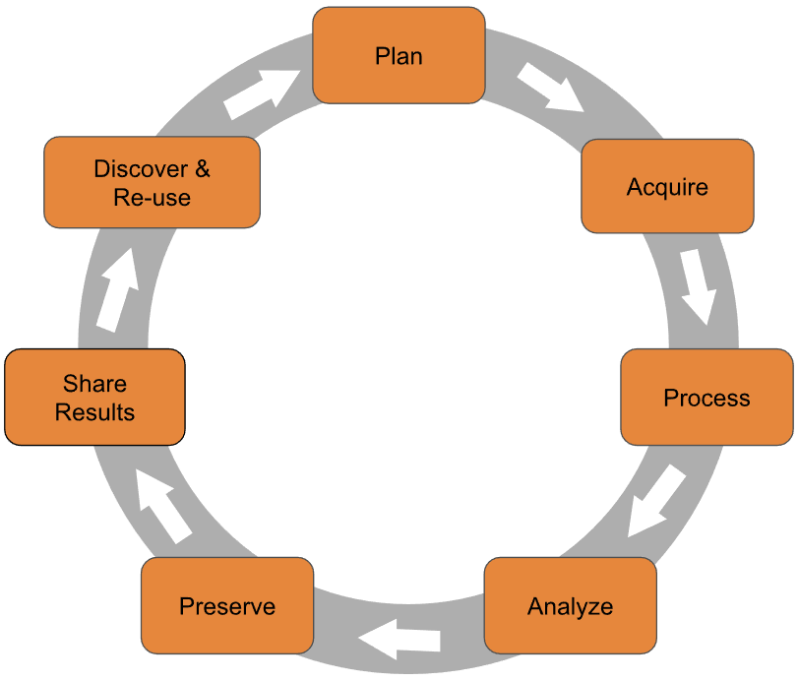
What is a Data Management & Sharing Plan?
A Data Management & Sharing Plan is a 2-page document that describes how you will manage your data during and after the project.
Consider: How does the data management lifecycle apply to your research?

Slide 4
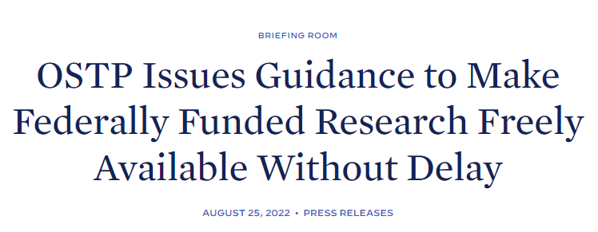
Federal Funder Requirements
Data Management & Sharing Plans (DMSP) or Data Management Plans (DMP) have become a common requirement
NIH’s Data Management & Sharing Policy (DMS Policy) has updated their DMSP requirements
On August 25th, 2022 the Office of Science and Technology Policy (OSTP) released a memorandum making all publications and their supporting data from federally funded research publicly accessible without an embargo.
This is an update from their 2013 memorandum which requiring only agencies with $100 million + in funding to develop a public access plan.

Slide 5
DMSP - A Living Document
Submitted as part of the grant application process, it can be used to evaluate a research projects merit for funding.
Inspected during performance period reviews to ensure it is being followed
A Data Management & Sharing Plan may need to be updated during the course of research. This is not a bad thing!

Slide 6
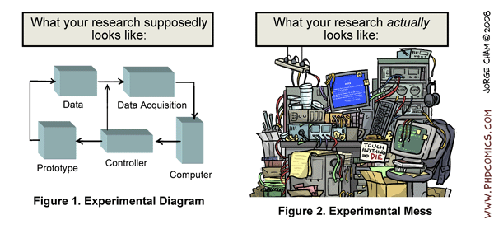
Not just for funded research!
Commonly developed by research teams who need to outline a plan for their data
Projects are becoming more collaborative, spanning internationally, and utilizing multiple software platforms & tools.
Cham, Jorge. (2008). "Research Diagram/Research Reality“. PhD Comics.

Slide 7
Why write a DMSP?
Organize how you think about your research
Makes you address research data management actions that are done unconsciously or ignored
Clarified roles & responsibilities
Promotes ethical research

Slide 8
Elements of a DMSP
Find the specific DMSP requirements in the Request for Proposals (RFP), the online grant proposal guide, or the guide on data sharing by the funder.
The NIH has outlined 6 Elements that are required to be addressed in the DMSP.
Elements of an NIH Data Management and Sharing Plan
Your NIH Institute, Center, or Office may have more specific requirements on top of the baseline NIH requirements.
Document structure and content in DMSP’s/DMP’s are unique for each funder, but overall they have common elements that all need to be addressed.

Slide 9
Elements of a DMSP
Data Description
A concise description of the data you work with, such as content, coverage, and data type.
Usually means the general category, such as text or numeric.
Data Format
The file formats you have chosen and why.
Remember - data often changes formats throughout the research process.
Data Volume
The amount of data being produced or used.
For example – “I expect to produce x GB of data” or “I expect to produce 10 csv spreadsheets”
Data Collection
The method of data collection and processing.
Include any standards used (ex: ISO 8601; Observational Medical Outcomes Partnership (OMOP) Common Data Model (CDM)), quality assurance practices, and data organization practices engrained in the collection and processing phases.
Examples: calibration, standardized data capture, utilizing controlled vocabularies.

Slide 10
Elements of a DMSP
Metadata & Documentation
The documentation and metadata used to make data discoverable, accessible, and interoperable.
Phase focuses on metadata and documentation for sharing.
Examples: README.txt files, data dictionaries, codebooks
Ethics & Privacy
The method you obtained consent from participants to preserve and share data, and how you are protecting their privacy.
Examples: de-identification, managing access procedure, etc.
Intellectual Property Rights
Who owns the copyright or intellectual property of the data used and developed.
Are there any limitation on data sharing after the project conclusion?
Storage & Security
How the data will be stored, secured, and backed up during the research project.

Slide 11
Elements of a DMSP
Data Sharing
How you will share the data to make it available, the timeline of when you will make it available, and who will be able to use it.
The goal is to make the data as available as possible while still following ethical and legal policies.
Data Repository
What data repository you have chosen.
It is best to show you have contacted the data repository before the grant application to get details and confirm your project is a good fit for the repository.
Preservation
The plans for data preservation, such as length of data retention in a repository and resources need to prepare the dataset for deposit.
Roles & Responsibility
Who is responsible for all the data related activities.
In collaborative projects, how will data management responsibilities be organized?

Slide 12
Elements of a DMSP
Budget
The fiscal resources needed to deliver on the plan outlined above.
Remember – it takes training and time to develop the skills listed above. It might be a smart idea to consider requesting funds for a dedicated data manager (if allowable in the grant) if the project is large and complex enough.
Related Policies
Any other data management policies that you will need to follow.
They may be federal, state, institutional, or departmental policies.

Slide 13
Utilizing DMPTool
DMPTool is a free, open-source, online tool used to fill out funder specific DMSP/DMP templates. It can greatly improve your DMSP writing, and it provides guidance along with the template as well.
We are going to walk through DMPTool and allow you time to set up an account

Slide 14
Mock DMSP Activity
Instructions:
Choose a funder from the list
Make a mock DMSP plan using a template, for either a real or fake project
Add me (lphegley@upenn.edu) as your collaborator
Don’t worry about it being perfect, or close to finished!
I’ll call you all back once time is up.
Feel free to ask questions.

Slide 15
DMSP Assistance
DMPTool – the tools itself, supporting documentation for researchers, and DMP guidance
DMPTool for Data Management Plans – guide on setting up a DMPTool account and on how to find an appropriate data repository
Research Data & Digital Scholarship – experience with data management and can assist you with writing and reviewing your DMP
Business Administrator/Research Support Services – for questions about your school’s grant process, reach out to your research support personnel

Slide 16
Workshop Wrap Up:
Today we learned:
- The basic requirements of a data management plan
- How to utilize DMPTool
- The available on-campus DMSP assistance

Slide 17
Connect with us!
Lauren Phegley, Research Data Engineer
lphegley@upenn.edu
Aman Kaur, Health Literacy Librarian
amankaur@pobox.upenn.edu
Laurel Graham, Head of Dental Library
laurel@pobox.upenn.edu
Website: https://www.library.upenn.edu/page/research-data-digital-scholarship
Spring 2023 Sessions:
Jan 19th 11-12: Complying with the NIH Data Management & Sharing Policy
Feb 14th 11-12: Using DMPTool to Write a Data Management Plan (DMP)
March 16th 11-12: Selecting a Data Repository

Slide 18
Resources
Data Management General Guidance. DMPTool. https://dmptool.org/general_guidance
DMPTool for Data Management Plans. Penn Libraries. https://guides.library.upenn.edu/dmp
DMPTool Themes (2019). DMPTool. https://github.com/CDLUC3/dmptool/wiki/themes
Quick Start Guide for Researchers. DMPTool. https://dmptool.org/quick_start_guide
SPARC’s Federal Agency Data Sharing Requirements Tool. SPARC. http://datasharing.sparcopen.org/data

